Slide 1

NBC classifier on Product Reviews
INFO 6105
Parth Kalani
002766306

Slide 2

Problem Statement
Scrape about 10,000 reviews on any product of your choice and label each review as negative if its rating is 1 or 2, else positive if its rating is 4 or 5.
Build an NBC classifier and evaluate the performance with 80/20 split.

Slide 3
Technical Approach
Scrape Data
Install google_play_scrapper library
Scrape Data
Use library to scrape data for Instagram reviews
Count reviews
Count the reviews for each score
Create NBC Classifier model
Test
Run the model on Test dataset
Model
Create Dataframe from scraped data
Train-test split
Create Train-Test split
Train the model

Slide 4
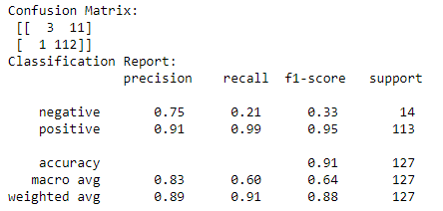
Results

